Slide 1
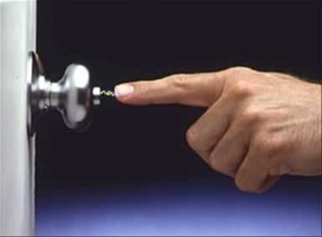
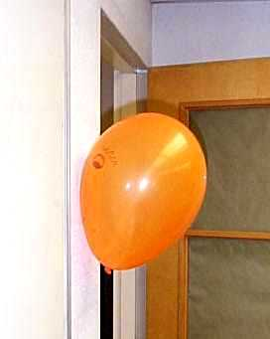
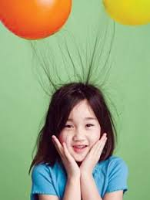
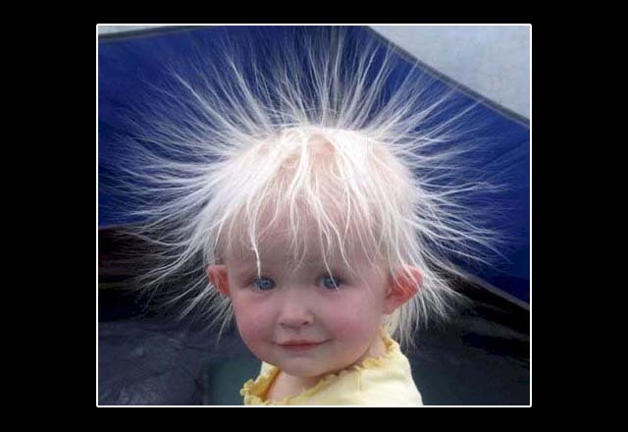
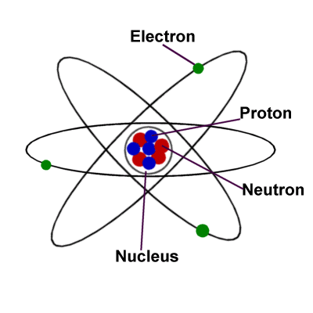
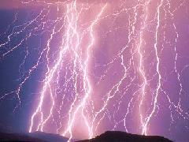
Electrostatics (Static Electricity)
Atom review
Charged Objects
Laws of electric charges
Electrostatic Series
Sparks and Lightning

Slide 2
Electricity
What is it made of?
Where does it come from?

Slide 3

Electric Fun!
You walk across the rug, reach for the doorknob and..........ZAP!!! You get a shock.
Or, you come inside from the cold, pull off your hat and......BOING!!! All your hair stands on end.
What is going on here?
What is it that is moving around?
And why does it happen more in the winter?

Slide 4
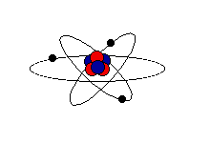
REVIEW: PARTS OF AN ATOM
In the middle of each atom is a nucleus. The nucleus contains two kinds of tiny particles, called protons and neutrons.
Orbiting around the nucleus are even smaller particles called electrons.

Slide 5
ELECTRICAL CHARGES
Particle | CHARGE | MASS
Proton | +1 | HUGE
Neutron | n (neutral) | HUGE
Electron | -1 | tiny

Slide 6
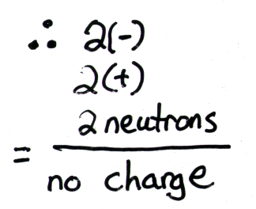
Neutral Objects
Atoms:
When the number of protons in an atom equals the number of electrons, the atom itself has no overall charge, it is neutral.

Slide 7
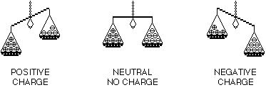
Charged Objects
Static electricity is the imbalance of positive and negative charges.
Atoms that lose electrons have more +’ve charges (protons) than –’ve charges (electrons). It is positively charged.
An atom that gains electrons has more –’ve than +’ve particles. It has a negative charge.

Slide 8

Stealing or Giving Away Electrons
Friction: One very common way is to rub two objects together. Electrons may be transferred (or moved) from one to the other.
The more rubbing, the more electrons move

Slide 9
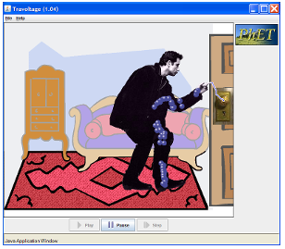
Friction and Charge Build-up
View the simulation below and observe what occurs when friction increases

Slide 10
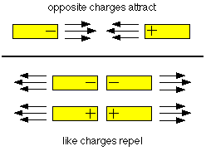
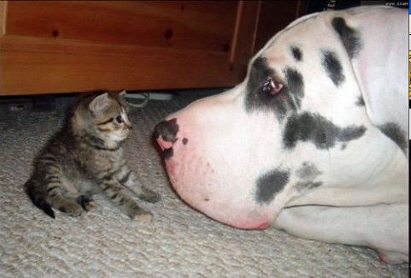
Law of Electric Charges
Law 1: Opposites attract: Two things with opposite, or different charges (a positive and a negative) will attract, or pull towards each other.
Law 2: Things with the same charge (two positives or two negatives) will repel, or push away from each other.

Slide 11
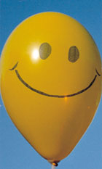
Law 3
Positive attracts Neutral objects, AND
Negative attracts Neutral objects
WEIRD!.... But Why?

Slide 12
Charging Objects
There are 3 ways an object can become charged
1) Friction
2) Contact
3) Induction

Slide 13
Friction Review
Static electricity is produced by rubbing different surfaces together
This causes both surfaces to obtain a different charge
Before rubbing: both objects are neutral
After rubbing, one object loses electrons (becomes positively charged), the other object gains electrons and becomes negatively charged

Slide 14
Contact Transfer
Contact is common and is the cause of static shocks.
Contact transfer occurs when a charged object is brought into contact with a differently charged object.
(This includes neutral objects)
Some or all of the electrons will transfer between the two objects in an attempt to balance the charge.

Slide 15
Static Shocks
In the case of static electricity, your body has developed some level of negative charge.
When you move your hand towards an uncharged objects (especially metals) the excess electrons you have transfer to that object.
The movement of the electrons can sometimes be seen as a spark and can occasionally be painful due to the speed at which the electrons transfer.

Slide 16
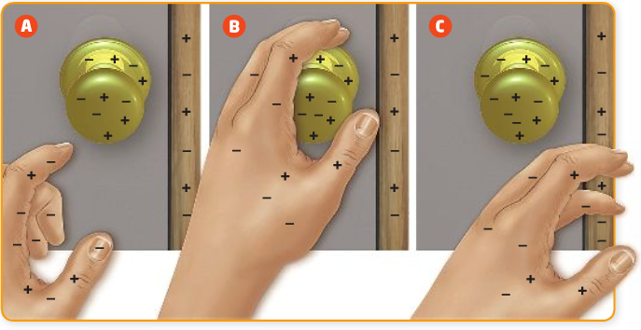

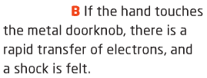
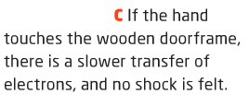

Slide 17
Induction
An electric charge is transferred from one substance to another without direct contact.
The induced charge is opposite to that of the charged object producing the charge

Slide 18
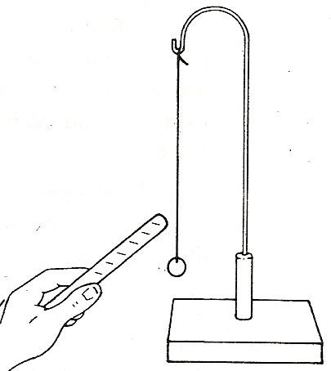
Pith Balls and Charge Transference
Pith balls by nature are usually uncharged to begin with (as are most objects)
  How would you expect them to react to a charged object brought nearby?
If a charged object and a pith ball are brought in contact some of that charge will transfer to the pith ball.
(Either the pith ball will gain or lose electrons)

Slide 19
Pith Balls and Charge Transference
Once the charged object is removed the charge remains on the pith ball
  How would you expect the pith ball to react if another similarly charged object were brought near to it?
  How would it react if an oppositely charged object were near?

Slide 20
Drawing!
In your notes draw a picture of the following situation. You should have at least three pictures to depict the scene.
A neutral pith ball is brought near to a negatively charged rod. The pith ball and the rod touch. The rod is removed and a different negatively charged object is brought near.

Slide 21
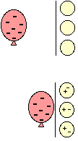
A Neutral Wall Attracts a Balloon
If you charge a balloon by rubbing it on your hair, it picks up extra electrons and has a negative charge. Holding it near a neutral wall will make the negative charges in the wall move away. Why?

Slide 22
Balloon Example
Like charges repel!!
The result is that there are more positive charges closer to the negative balloon and therefore, attraction.

Slide 23
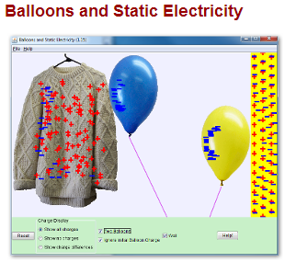
Balloon Example
Click the image below

Slide 24
BAD HAIR in the WINTER
So what does all this have to do with shocks? Or hair full of static?
When you take off your wool hat, it rubs against your hair. Electrons move from your hair to the hat. Now each of the hairs have the same positive charge.

Slide 25
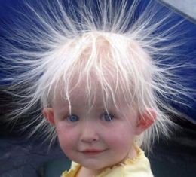

BAD HAIR in the WINTER
Things with the same charge repel each other. So the hairs try to get as far from each other as possible.
Static Electricity

Slide 26
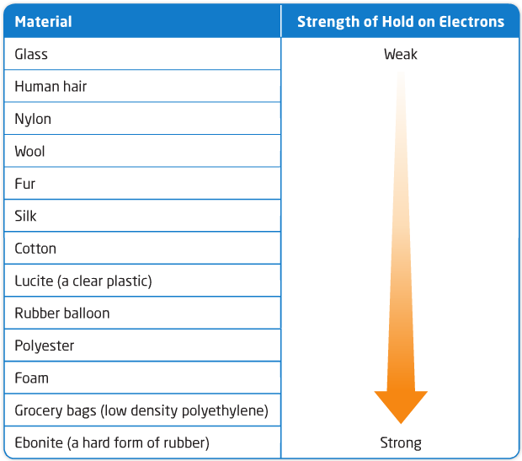
Which substance will take and which will give their electrons?
Electrostatic Series:
An electrostatic series is arranged in terms of the relative “hold” that different materials
have on their electrons.
If you go down the list the items have a tendency to gain electrons and up the list the tendency to lose electrons.

Slide 27
Electrostatic Series
If you rub human hair and wool together, which will lose and which will gain electrons?
Lucite and Silk?
Rubber and Cotton?
Glass and Foam?

Slide 28
Sparks
If there are enough positive (+) charges on one object and enough negative (−) charges on the surface of the other object the electrons might jump the air gap between causing a spark (Lightning!!)
Lightning Videos

Slide 29

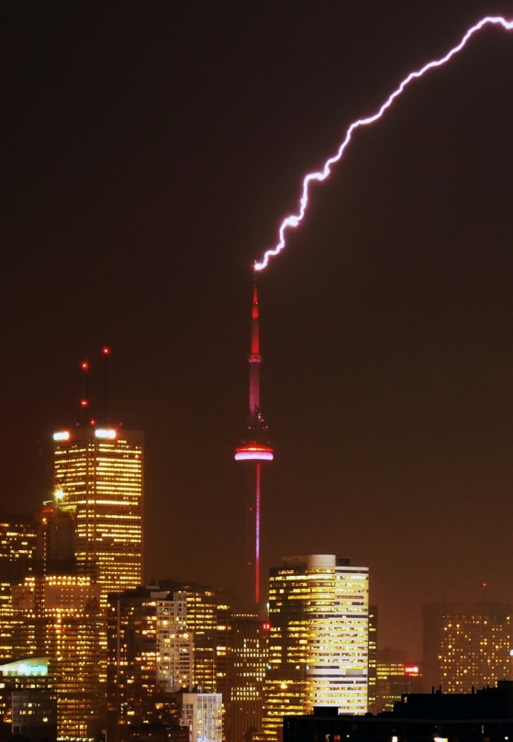
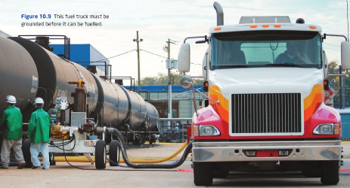
Static Electricity Applications
Grounding
Dangers of static
Lightning

Slide 30
Grounding
Grounding is the process of removing a charge from an object by adding or removing electrons
It is called “grounding” because the process involves connecting the charged object to the ground directly or via a conductor.
The process is also called “discharging”

Slide 31
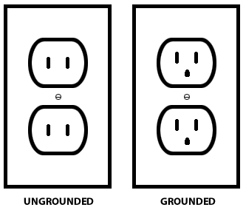
Grounding
The third plug on a typical electrical outlet is the ground. It takes the excess electrical buildup and sends it into the ground.
Grounding works because the earth (ground) has so many electrons that no matter how many are added or taken it is still essentially a neutral object.

Slide 32
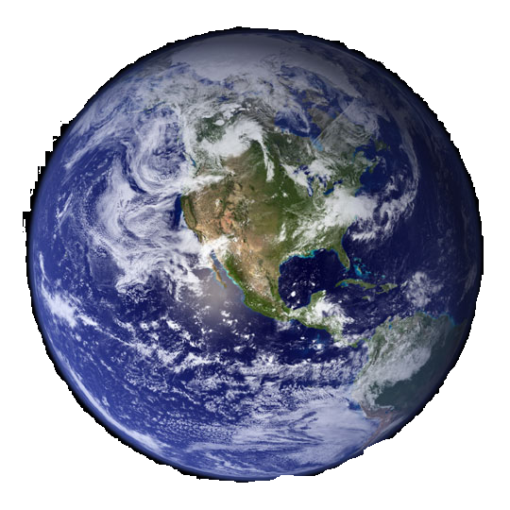
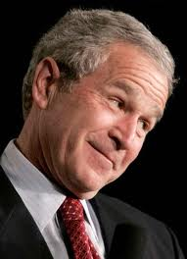

1 Earth = approximately
6.91 x 10⁹⁶ electrons
1 Human = approximately 2.83 x 10²⁹ electrons
The Earth has 10⁶⁷ more electrons than a person

Slide 33
Grounding Examples
Static discharge can be dangerous, therefore precautions must be taken to reduce the build-up of electrons
Ex:
  Fueling stations: static electricity can ignite the fuel and cause explosions
  Surgeons: wear protective booties to prevent static buildup - anesthesia is explosive and electrical devices such as pacemakers can be damaged by sparks

Slide 34
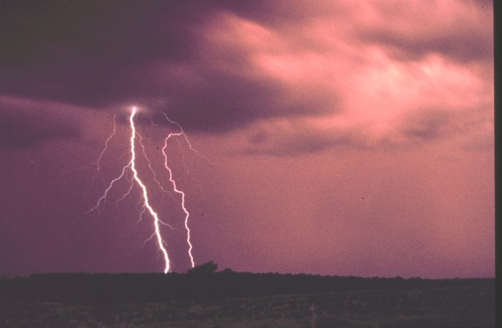
Lightning
Becomes very “negative”
Becomes very “positive”

Slide 35
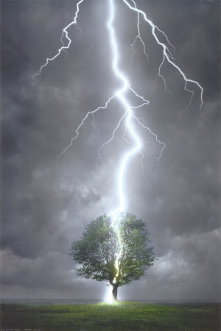
Lightning!!!
Storm clouds form when humid, warm air rises to meet a colder air mass
As these air masses churn together, lightning can be created
Lightning strikes when negative charges at the bottom of a cloud are attracted to positive charges on the ground

Slide 36
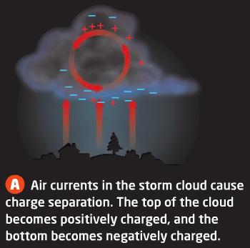
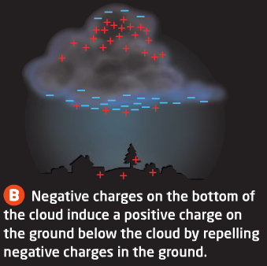
Lightning!!!

Slide 37
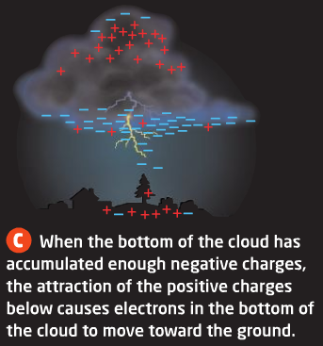
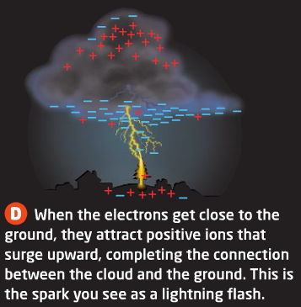
Lightning!!!

Slide 38

Lightning Rods
Lightning takes the path of least resistance usually hitting the highest object in an area
Most lightning strikes are unavoidable therefore many buildings including homes have lightning rods
  The CN Tower gets hit 40-50 times per year with lightning

Slide 39
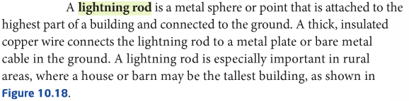
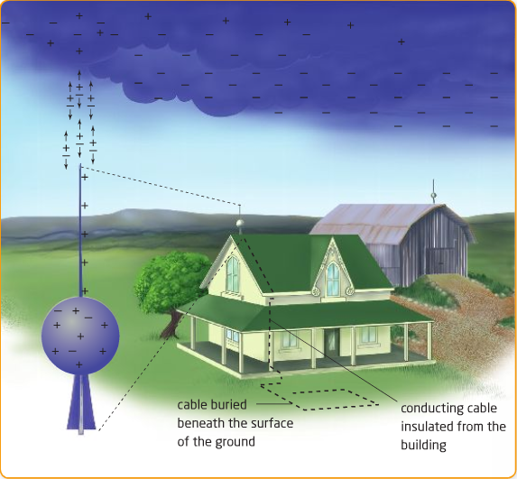

Slide 40
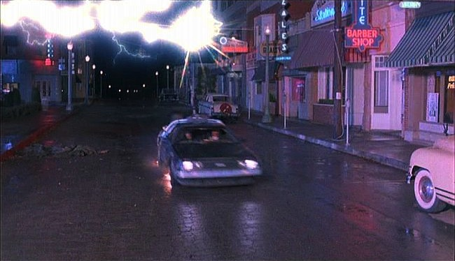
Lightning and your car
Why is your car a good place to be during a lightning storm?
It has rubber tires
It has a metal exterior
It’s warm and comfy

Slide 41
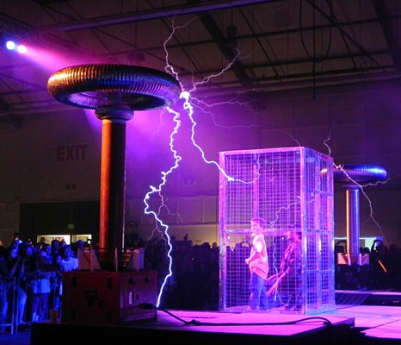
Lightning and your car
a)
b) It has a metal exterior
c)
Your tires do nothing it’s the metal cage (called a Faraday Cage) around you that attracts the electricity and keeps it from you.

